Slide 1




C++ Workshop

Slide 2
Introduction to C++
C++ is a powerful, high-performance programming language that's widely used in software development, including game development, systems programming, and applications requiring high performance.
Key features of C++:
OBJECT-ORIENTED PROGRAMMING (OOP): C++ SUPPORTS OOP PRINCIPLES LIKE CLASSES, INHERITANCE, POLYMORPHISM, AND ENCAPSULATION, WHICH HELP IN ORGANIZING AND MANAGING COMPLEX PROGRAMS.
LOW-LEVEL MANIPULATION: IT ALLOWS FOR DIRECT MANIPULATION OF HARDWARE AND MEMORY, WHICH IS USEFUL FOR SYSTEM-LEVEL PROGRAMMING.
PERFORMANCE: C++ IS KNOWN FOR ITS PERFORMANCE AND EFFICIENCY, MAKING IT IDEAL FOR APPLICATIONS WHERE SPEED AND RESOURCE MANAGEMENT ARE CRITICAL.

Slide 3
Syntax / Structure
Every C++ program has these:
Headers
Using Namespace and Standard (std) library
The ‘Main’ Function
Statements and Expressions
Declaring variables and using various data types for them

Slide 4
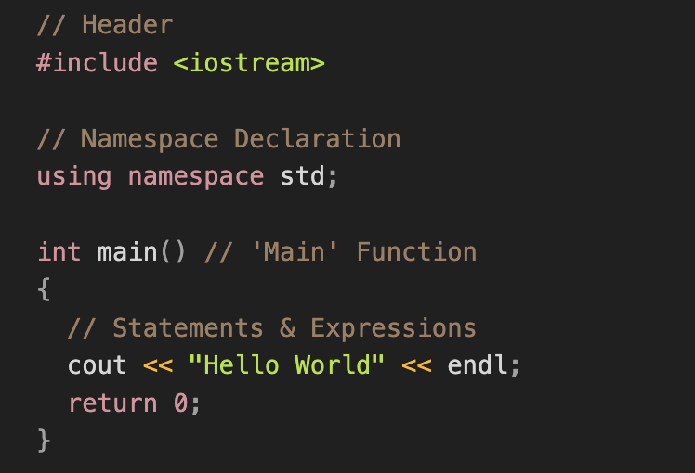
Syntax / Structure

Slide 5

Data
Types
DATATYPES
A data type gives the type of date any variable can store. For example, numbers, characters, decimals, etc.
INTEGER
FLOATING POINT (DECIMAL)
CHARACTER
INT
LONG
SHORT
FLOAT
DOUBLE
STRING
CHAR

Slide 6
int - stores integers (whole numbers), without decimals, such as 123 or -123
float - holds floating values up to 7 digits.
double - that is used to store floating-point values up to 15 digits
char - stores single characters, such as 'a' or 'B'. Char values are surrounded by single quotes
string - stores text, such as "Hello World". String values are surrounded by double quotes
bool - stores values with two states: true or false
Data
Types

Slide 7
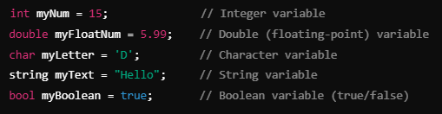
Data
Types

Slide 8
Global and Local Variables
1. Local Variables
A local variable is declared inside a function, block, or method and is accessible only within that scope.
It is created when the block or function is called and destroyed when the block or function finishes execution.
Scope: Limited to the function or block where it is declared.
Lifetime: Exists only during the function or block execution.

Slide 9
Global and Local Variables
2. Global Variables
A global variable is declared outside of all functions and is accessible from any function within the same program after its declaration.
Scope: Available throughout the entire program, starting from the point of declaration.
Lifetime: Exists for the entire duration of the program (from start to end).

Slide 10
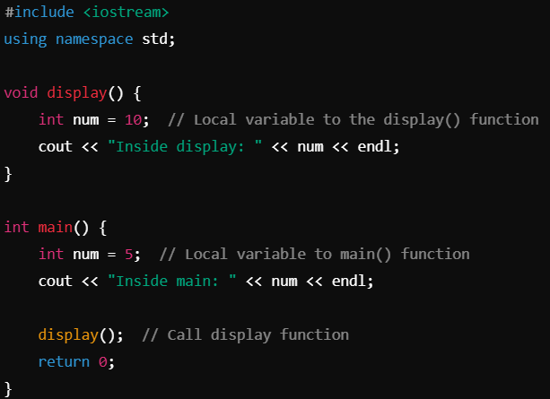
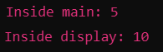
Global and Local Variables
1. Local Variables
Output:

Slide 11
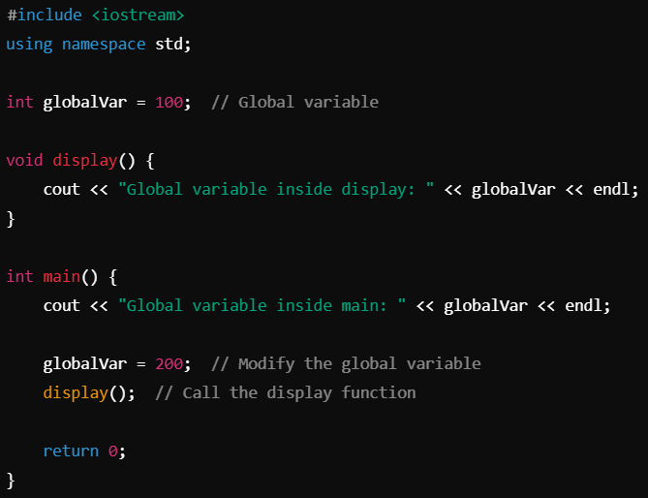
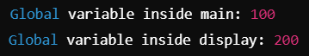
Global and Local Variables
2. Global Variables
Output:

Slide 12
OPERATOR | Type
++, -- | Unary Operator
+, -, *, /, % | Arithmetic Operator
<, <=, >, >=, ==, != | Relational Operator
&&, ||, ! | Logical Operator
&, |, <<, >>, -, ^ | Bitwise Operator
=, +=, -=, *=, %= | Assignment Operator
?: | Ternary Operator
Unary
Operators
Binary
Ternary

Slide 13
OPERATOR | Precedence
++, -- | First
*,/,% | Second
+, - | Third
<, <=, >, >= | Fourth
==, != | Fifth
&& | Sixth
|| | Seventh
= | Last
Unary
Operators
Precedence
Binary

Slide 14
TEST
CONDITION
False
If
Statments
True
IF BLOCK
STATEMENTS AFTER
IF BLOCK

Slide 15
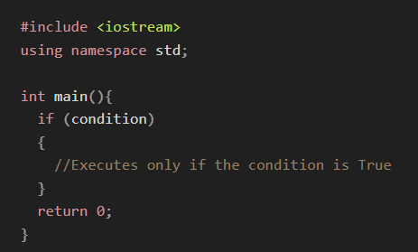
If
Statments

Slide 16
TEST
CONDITION
False
ELSE BLOCK
If Else
Statments
True
IF BLOCK
STATEMENTS AFTER
IF/ELSE BLOCK

Slide 17
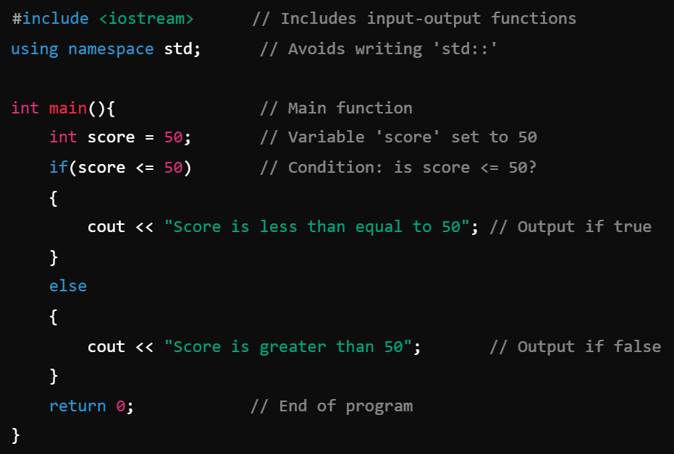
If Else
Statments
Conditional choice between two actions

Slide 18
TEST
CONDITION 1
IF BLOCK 1
True
False
Else If
Statments
TEST
CONDITION 2
ELSE IF BLOCK 2
True
False
ELSE BLOCK
STATEMENTS AFTER
IF/ELSE BLOCK

Slide 19
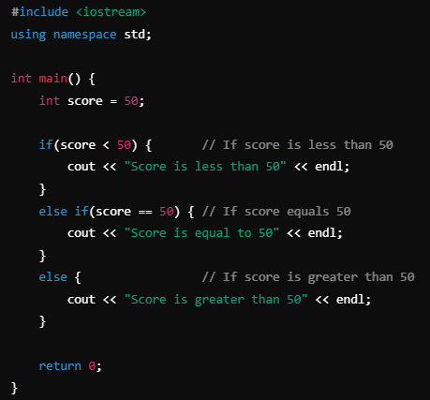
Else If
Statments

Slide 20
TEST
EXPRESSION
True
NESTED TEST EXPRESSION
False
Nested If
Statments
False
True
BODY OF
ELSE
BODY OF
NESTED IF
BODY OF
NESTED ELSE
STATEMENT BELOW
JUST IF

Slide 21
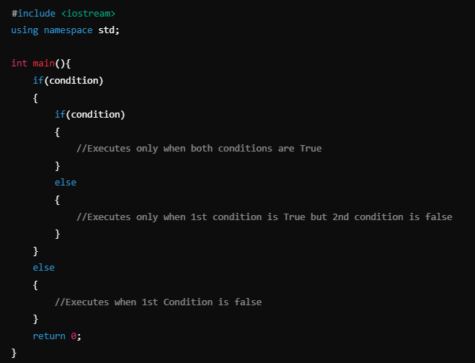
Nested If
Statments

Slide 22
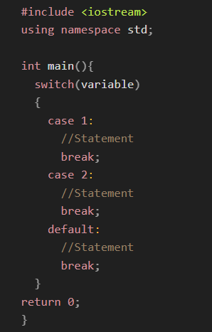
Switch Case
It is an alternative to using multiple if-else statements when you need to compare a variable against different constant values.
Note: Only int, char and enum can be used in switch-case

Slide 23
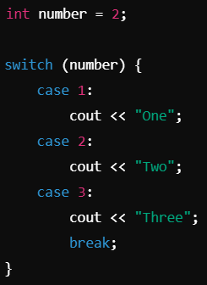

Switch Case (Fall-through Behaviour)
If you omit the break statement, the code will "fall through" to the next case, which means multiple case blocks can be executed in sequence.
Output:

Slide 24

Loops
Enters the Loop
Loops are control structures that allow you to execute a block of code repeatedly. C++ provides several types of loops, each suited for different situations.
TEST
EXPRESSION
No
Exits the Loop
Yes
STATEMENT

Slide 25
LOOPS
Loops
ENTRY COTROLLED
EXIT CONTROLLED
FOR
WHILE
DO-WHILE

Slide 26
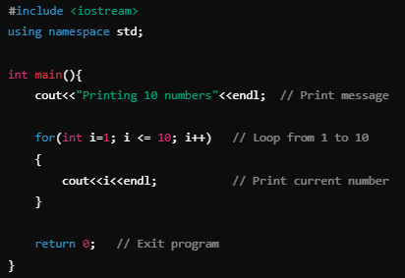
For
Loops

Slide 27
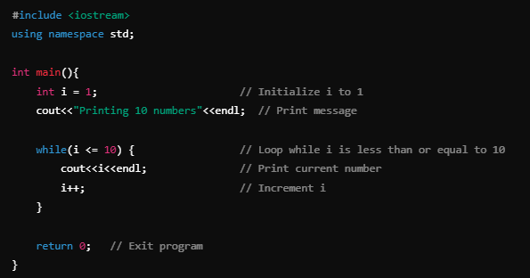
While
Loops

Slide 28
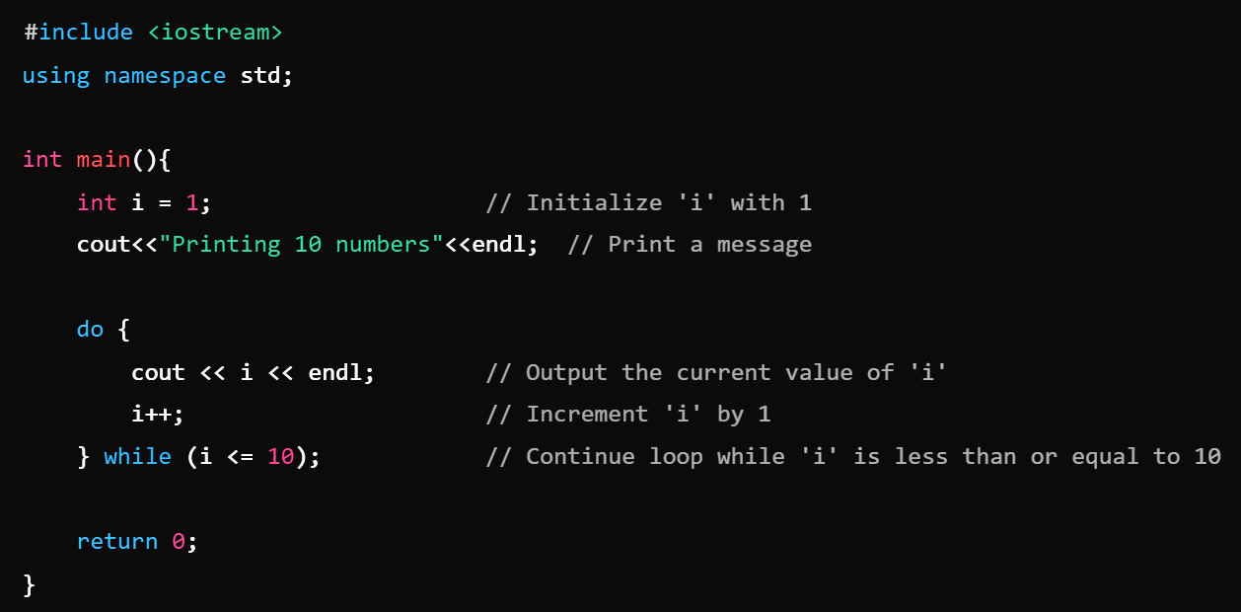
Do-While
Loops

Slide 29
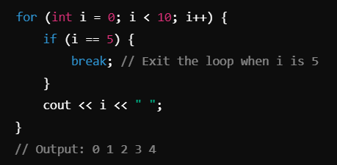
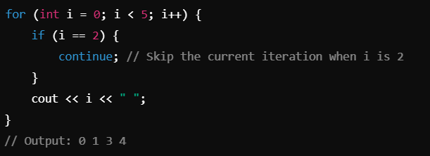
Loop Control Statements
1) break: Exits the loop immediately, even if the loop condition is still true.
2) continue: Skips the rest of the loop body for the current iteration and continues with the next iteration.

Slide 30
Nested Loops
Enters the Loop
In C++, nested loops refer to a loop inside another loop.
The inner loop is executed completely for each iteration of the outer loop.
This structure is useful when dealing with multi-dimensional data, such as in 2D arrays or grids, and for performing repeated tasks that require multiple levels of iteration.
TEST
EXPRESSION1
No
Exits Loop 1
Yes
TEST
EXPRESSION2
No
Yes
Exits Loop 2
STATEMENT

Slide 31
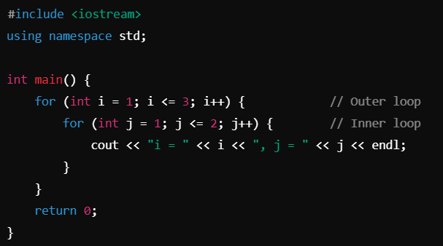
Nested Loops

Slide 32
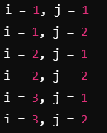
Nested Loops
Output

Slide 33
Arrays and Strings

Slide 34

Arrays
In C++, an array is a data structure that allows you to store multiple elements of the same data type in a contiguous block of memory. The following are the properties of arrays:
Arrays have a fixed size, which means the number of elements they can hold is determined when the array is created and cannot be changed during runtime.
Indexed: Elements in the array can be accessed via their index, which starts at 0 for the first element and goes up to (size - 1) for the last element.
Homogeneous: All elements in the array must be of the same type (e.g., all integers, all floats).

Slide 35
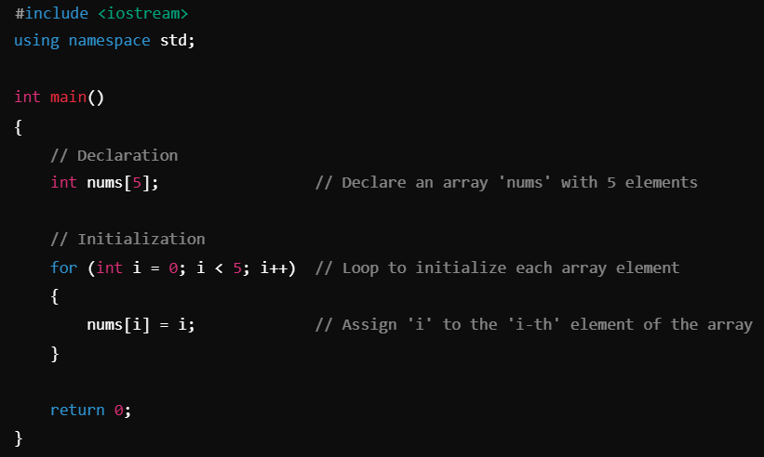
Arrays

Slide 36
Arrays (2D)
In C++, a 2D array (also known as a two-dimensional array or matrix) is essentially an array of arrays. It is used to store data in a tabular format with rows and columns.
2D Array Properties
Fixed size: The number of rows and columns is specified when the array is created and cannot be changed.
Indexed: Elements in the array can be accessed via their index as follows: array[Row index][Col index]
For example: int a[1][2]
Rows and columns: You need two indices to access an element — one for the row and one for the column.

Slide 37
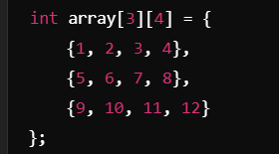
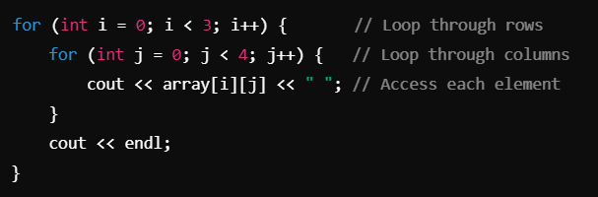
Arrays (2D)
Declaration and Initialization
Accessing elements using nested loops

Slide 38
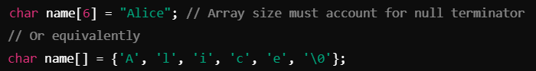
Strings
Strings are objects in C++ and are part of the Standard Template Library (STL).
A string is a sequence of characters used to represent text.
C++ provides two main ways to handle strings:
1. C-Style Strings

Slide 39
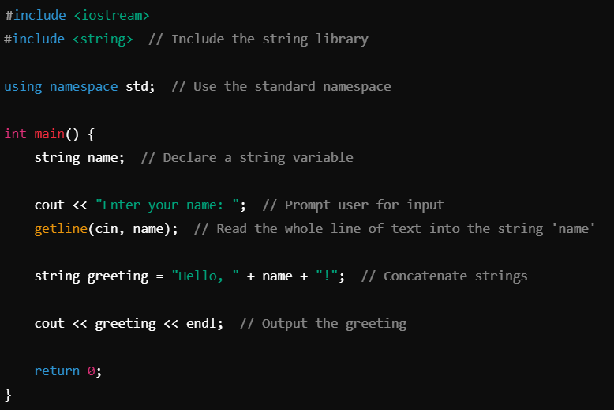
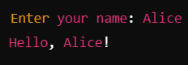
Strings
2. C++ Strings
Output :

Slide 40
A function is a block of code which only runs when it is called.
You can pass data, known as parameters, into a function.
A function can return data as a result.
Functions

Slide 41
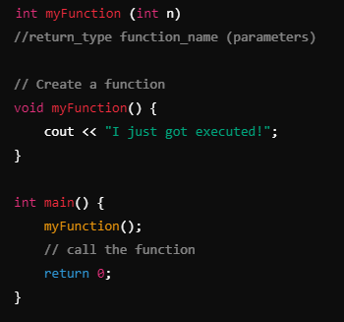
Syntax
Functions

Slide 42
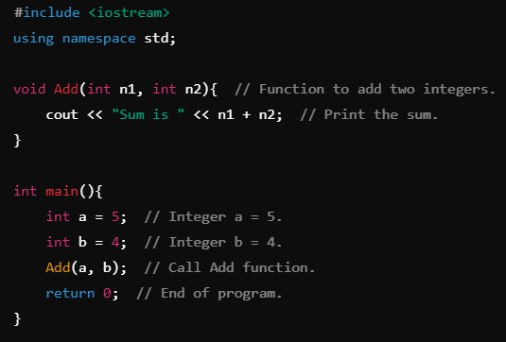
Call By Value
Functions
Function Calling

Slide 43
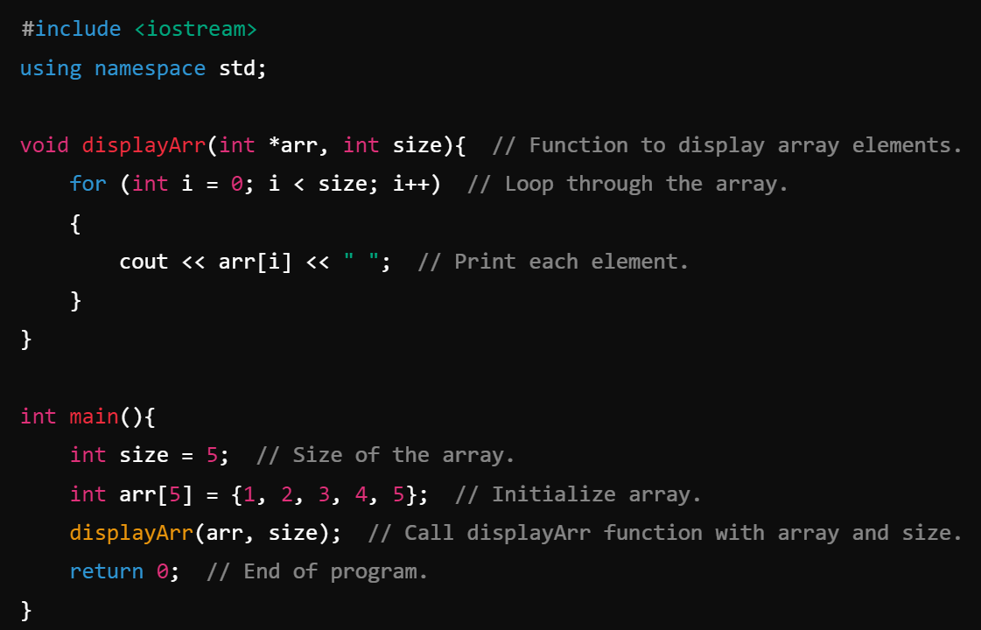
Call By Reference
Functions
Function Calling

